Slide 1
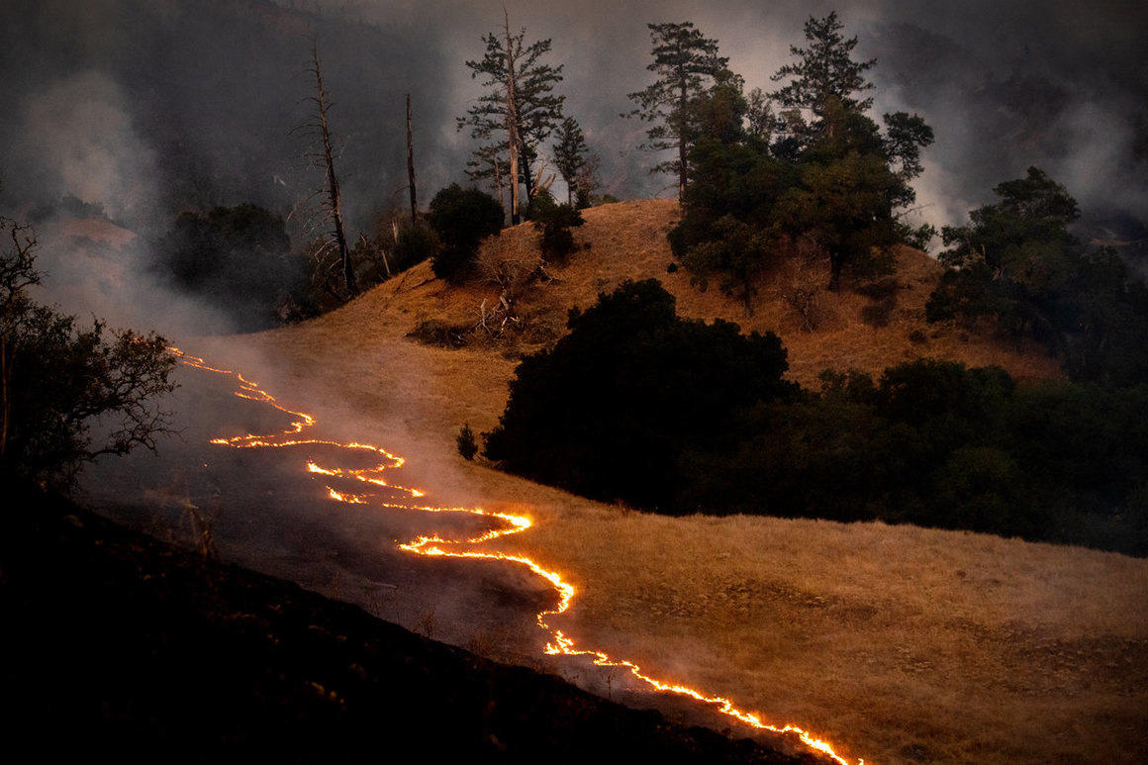
FireShield.AI – Wildfire Risk Detection & Shelter Locator
A Streamlit-powered AI Web App for Public Safety In recent years, wildfires have increasingly devastated communities across the United States, most notably in California, where entire neighborhoods have been destroyed, homes reduced to ashes, and lives disrupted in minutes. While property loss is evident, the real tragedy lies in the lack of accessible tools that help everyday people assess danger and act quickly.
Motivated by these events, I created FireShield.AI — a Streamlit-powered AI web
app designed to protect public safety by predicting wildfire risk by ZIP code and
locating nearby emergency shelters.
This project is not just about code — it’s about building something that can save
lives, increase preparedness, and bring technology to the front lines of disaster
response.

Slide 2

What is FireShield.AI?
Detects wildfire risk by ZIP code
Locates nearby emergency shelters
Interactive map display
Built for safety and social good

Slide 3

Tools Used
Python & Streamlit
Pydeck for map visualization
Zippopotam.us & ArcGIS APIs
GitHub for version control

Slide 4

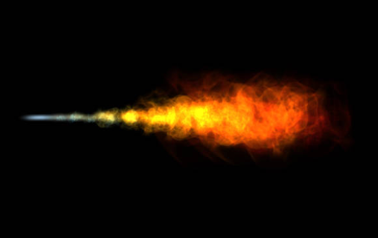
Get ZIP Coordinates
Uses Zippopotam.us API to fetch latitude and longitude for a ZIP code

Slide 5

Fire Risk Detection
Uses Haversine formula to detect proximity to wildfire hotspots

Slide 6

Locate Nearby Shelters
Pulls data from ArcGIS Shelter API or fallback CSV to display emergency shelters

Slide 7

Map Display
Displays user location and shelters using Pydeck map in Streamlit

Slide 8
Streamlit UI Design
Implemented custom CSS for a clean, user-friendly design

Slide 9

Upload to GitHub
1. Created GitHub repository
2. Uploaded code and README
3. Added project description

Slide 10
Final Thoughts
Saves lives with real-time location info
Clean and interactive interface
Live fire data & alerts, alternate fall back to offline data. Governments publishes when the fire in the state, it allocates schools, collages and churches as shelters. We can update fallback offline data in case if live data is not available.

Slide 11
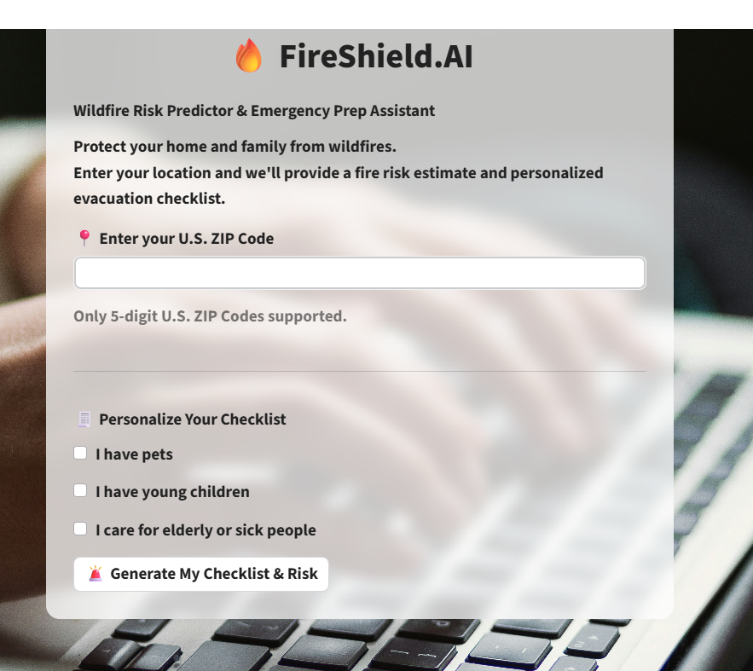
First application launch screen

Slide 12
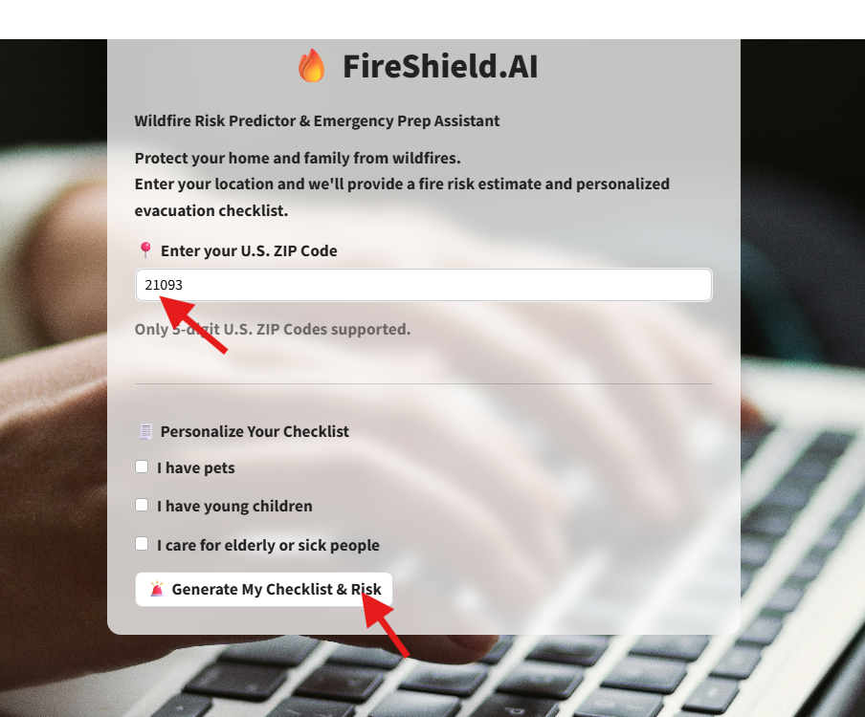
Search- Enter the zip code and click on Generate My Checklist & Risk

Slide 13
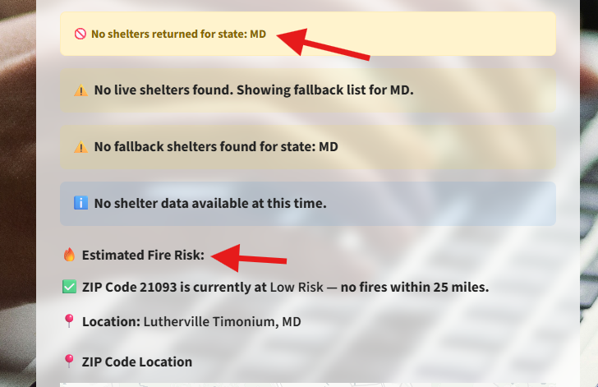
The result for entered zip code 21093-Shelters and Estimated Fire Risk There are no shelters from the live data and fallback shelters. Note: Fallback Shelters- The offline data stored in the Shelters_Full_Mock.csv file

Slide 14
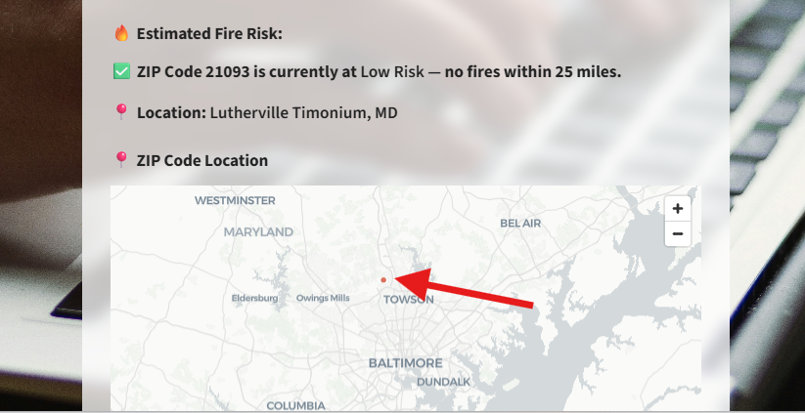
The result for entered zip code 21093-Location on the MAP

Slide 15
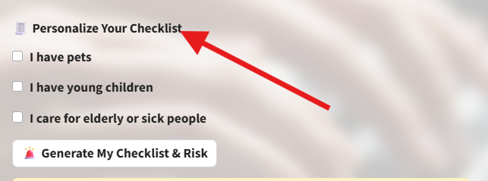
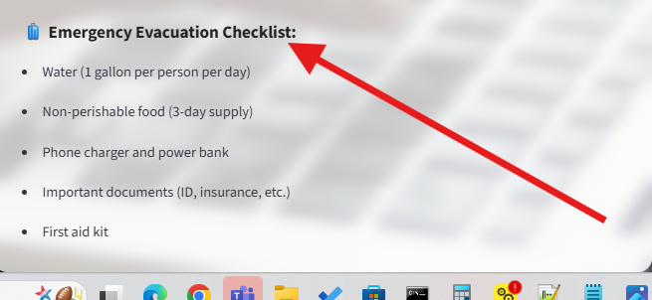
Default Emergency Evacuation Checklist before selecting any “Personalize Your Checklist”

Slide 16

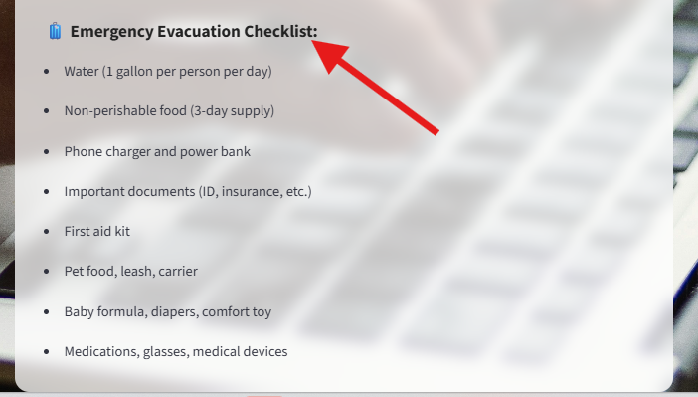
After selecting all “Personalize Your Checklist” the Emergency Evacuation Checklist

Slide 17
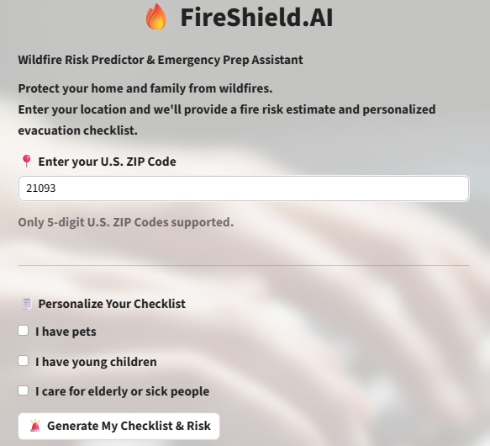
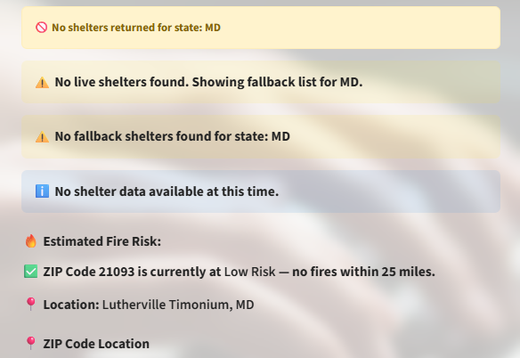
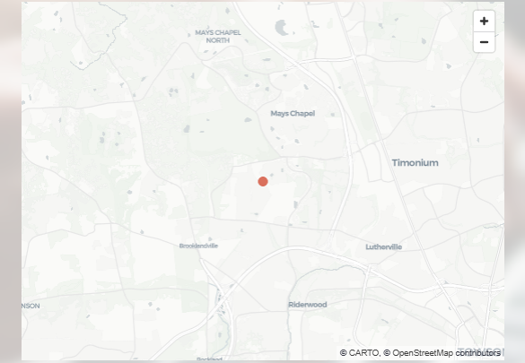
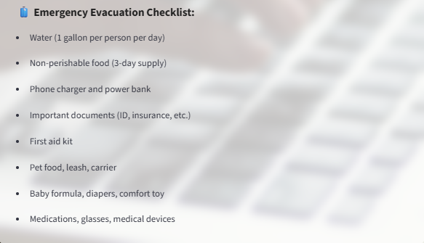
Complete result for the zip 21093

Slide 18
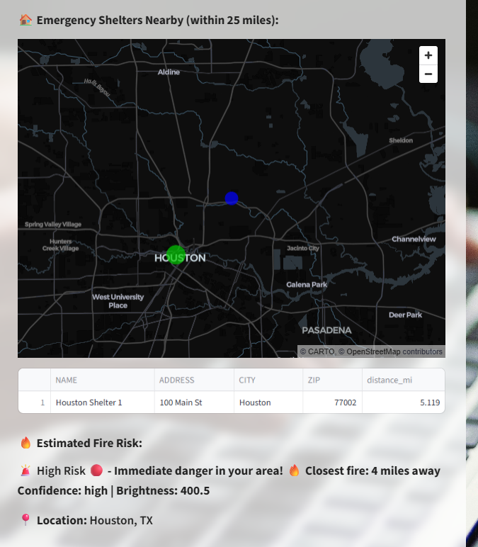
Search zip code 77001 Houston, Texas ( high risk). Showing nearly shelter by fallback list(since live data does not have any shelter). Blue dot represents searched zip, green dot represents shelter(on mouse over it shows zip and shelter respectively)

Slide 19
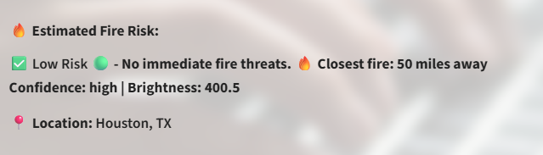
Conti.. Fire risk estimated. Fire 50 miles away(Low Risk)

Slide 20
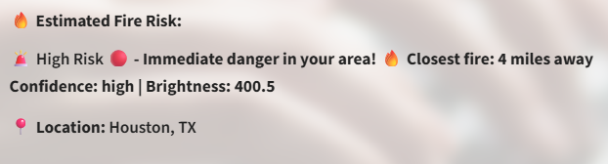
Conti.. Fire risk estimated. Fire <5 miles away(High Risk)

Slide 21
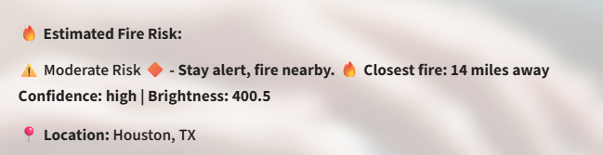
Conti.. Fire risk estimated. Fire 14 miles away(Moderate Risk)

Slide 22
How It Works – At a Glance
User enters a U.S. ZIP code
Application determines location coordinates
Fire risk is estimated using dummy or real fire data
Nearby emergency shelters are located (live or fallback)
Visual map with tooltips and checklist is displayed

Slide 23
Unique Features
Combines real-time and fallback data seamlessly
Visual map with ZIP code and shelter tooltips
Generates personalized evacuation checklist
Works even if live shelter data is unavailable
Built using Streamlit, pydeck, Pandas, and REST APIs

Slide 24
Final Thoughts
Impact:
- Instantly helps users evaluate wildfire risk
- Provides shelter guidance within 25 miles
- Supports users in preparing an emergency checklist
Future Work:
- Integrate NASA MODIS/VIIRS real-time fire data
- Add alert system via email or text message
- Introduce multilingual interface for broader access

